Slide 1



Operating System
Operating System

Slide 2

TABLE OF CONTENTS
01
03
steps taken by the computer when it is first turned on
METHODOLOGY
02
04
Name the types of operating systems, their developers and their advantages and disadvantages!
SUMMARY

Slide 3
01
steps taken by the computer when it is first turned on

Slide 4


STEPS TAKEN BY THE COMPUTER WHEN IT IS FIRST TURNED ON
When the computer is turned on, the power supply sends a signal to the motherboard to start the POST process.
During this process, the computer checks the basic hardware components, such as the RAM, hard drive, and CPU, to ensure they are working correctly.
Computer initializes the Basic Input/Output System (BIOS), which is a firmware that controls the hardware components of the computer.
The BIOS provides a set of instructions to the computer to configure and test the hardware, and then it locates and loads the bootloader.
The bootloader is a program that resides on the hard drive and loads the operating system (OS) into memory.
The bootloader typically gives the user the option to select which OS to load if multiple OSes are installed on the computer.
Power-on self-test (POST)
BIOS initialization
Bootloader

Slide 5
STEPS TAKEN BY THE COMPUTER WHEN IT IS FIRST TURNED ON
After the bootloader loads the OS, the OS initializes its own components, such as the kernel and device drivers.
The kernel is the central component of the OS that manages the computer's resources, such as memory and CPU, and communicates with the hardware components.
Once the operating system initialization is complete, the user is presented with a login screen where they enter their username and password to gain access to the computer.
After the user has successfully logged in, the computer loads the user's profile, which includes their personal settings, preferences, and files. This allows the user to start using their computer and launch applications.
Operating system initialization
Login
User profile loading

Slide 6
02
Name the types of operating systems, their developers and their advantages and disadvantages!

Slide 7

WINDOWS
DEVELOPED BY MICROSOFT
Windows is the most widely used operating system for desktop and laptop computers.
Its advantages include a wide range of software support, user-friendly interface, and compatibility with a large number of hardware devices.
However, it is known for being prone to viruses and malware, and it can sometimes be unstable.

Slide 8

MACOS
DEVELOPED BY APPLE
macOS is the operating system for Apple's Mac computers.
Its advantages include a streamlined and intuitive user interface, robust security features, and seamless integration with other Apple devices.
However, it has limited software support compared to Windows, and it is only compatible with Apple hardware.

Slide 9

LINUX
DEVELOPED BY A COMMUNITY OF DEVELOPERS
Linux is an open-source operating system that is known for its stability, security, and flexibility
It is highly customizable and can be tailored to meet the specific needs of different users.
However, it has a steeper learning curve than other operating systems, and software support can sometimes be limited.

Slide 10

ANDROID
DEVELOPED BY GOOGLE
Android is the most widely used operating system for mobile devices.
Its advantages include a wide range of apps, customization options, and seamless integration with Google services.
However, it can be prone to security vulnerabilities, and software updates can sometimes be slow to roll out.

Slide 11

IOS
DEVELOPED BY APPLE
iOS is the operating system for Apple's mobile devices.
Its advantages include a streamlined and intuitive user interface, robust security features, and seamless integration with other Apple devices.
However, it has limited customization options compared to Android, and it is only compatible with Apple hardware.

Slide 12
03
Name the types of operating systems, their developers and their advantages and disadvantages!

Slide 13

WINDOWS
Windows is a popular operating system developed by Microsoft. It is used on a wide range of devices, including desktop computers, laptops, tablets, and smartphones. It has a graphical user interface (GUI) and supports a wide range of software applications.
.

Slide 14
MACOS
MacOS is an operating system developed by Apple Inc. It is used exclusively on Apple computers and is known for its sleek and user-friendly interface. MacOS is often preferred by people who work in creative industries, such as design and music production.

Slide 15
LINUX
Linux is a free and open-source operating system that is widely used on servers, supercomputers, and other types of computing devices. It is highly customizable and can be tailored to meet specific needs. There are many different versions of Linux, known as distributions, each with its own set of features and tools.
is an operating system developed by Apple Inc. It is used exclusively on Apple computers and is known for its sleek and user-friendly interface. MacOS is often preferred by people who work in creative industries, such as design and music production.

Slide 16
UNIX
Unix is an older operating system that is still used today, particularly in enterprise computing environments. It is known for its stability, security, and reliability. Like Linux, Unix is highly customizable and can be tailored to meet specific needs.
is an operating system developed by Apple Inc. It is used exclusively on Apple computers and is known for its sleek and user-friendly interface. MacOS is often preferred by people who work in creative industries, such as design and music production.

Slide 17
CHROME OS
Chrome OS is a lightweight operating system developed by Google. It is designed to run on low-cost hardware, such as Chromebooks, and is highly optimized for web-based applications. It is simple to use and is ideal for people who primarily use their computers for browsing the web, using social media, and basic productivity tasks.

Slide 18
MOBILE OPERATING SYSTEMS
Mobile operating systems, such as Android and iOS, are used on smartphones and tablets. They are highly optimized for touch-based interfaces and support a wide range of apps and games. They are designed to be highly portable and energy-efficient, making them ideal for use on mobile devices.

Slide 19
Operating System
End

Slide 20

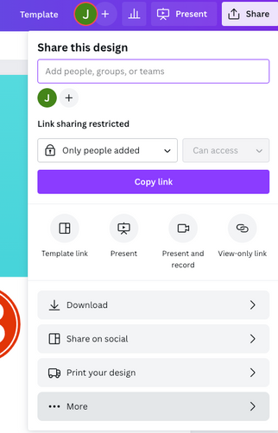
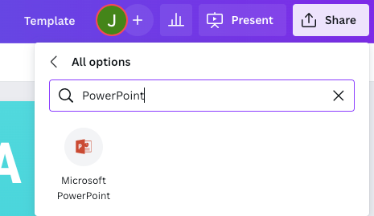
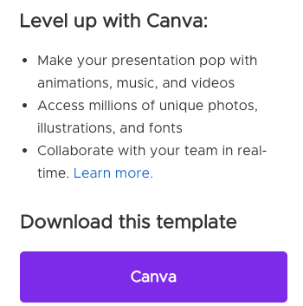
TYPES OF OPERATING SYSTEMS
1
2
3
Click on the "Canva" button next to this presentation. Start editing your presentation. You may need to sign in to your Canva account.
Click on the "Share" button on the top right corner in Canva and click on "More" at the bottom of the menu.
Enter "PowerPoint" in the search bar and click on the PowerPoint icon to download.

Slide 21
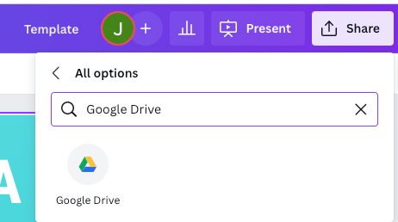
DOWNLOAD THIS PRESENTATION AS
A GOOGLE SLIDE TEMPLATE IN 3 STEPS
1
2
3
Click on the "Canva" button next to this presentation. Start editing your presentation. You may need to sign in to your Canva account.
Click on the "Share" button on the top right corner in Canva and click on "More" at the bottom of the menu.
Enter "Google Drive" in the search bar and click on the Google Drive icon to add this design as a Google slide in your G Drive. It will ask you to link your Google account to Canva the first time.

Slide 22
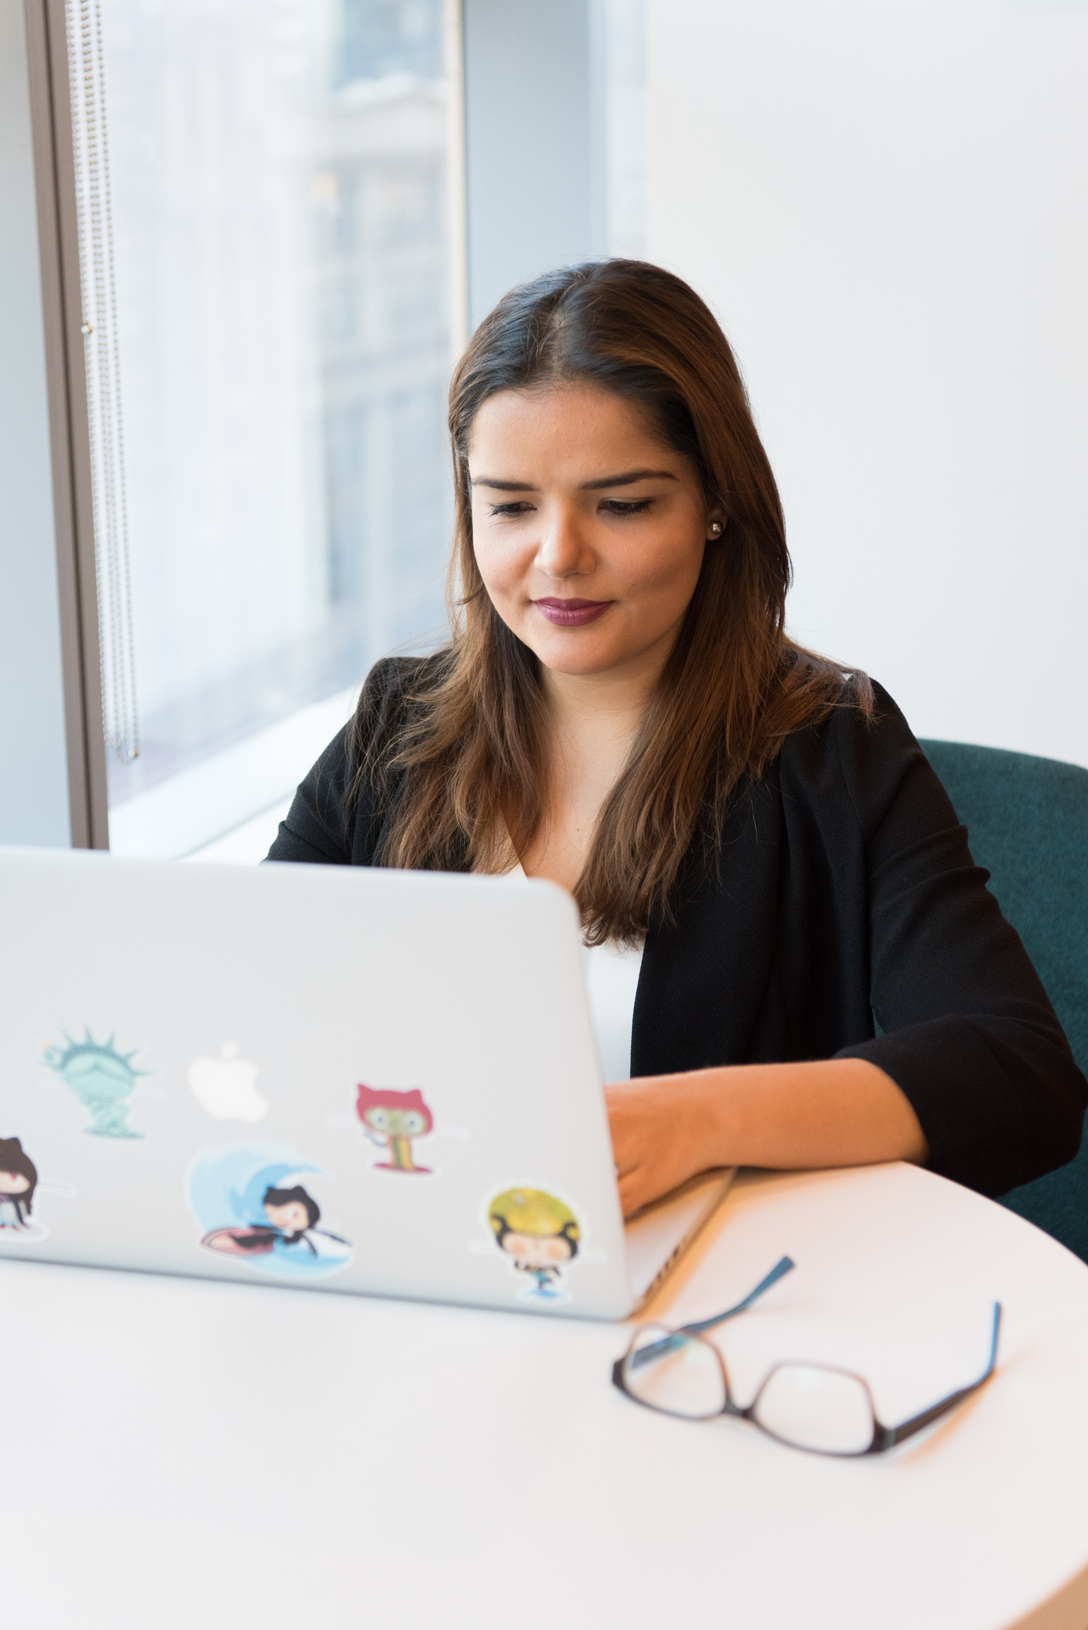

HELLO THERE!
I'm Rain. Welcome to my education presentation.
Follow me at @reallygreatsite to learn more.

Slide 23




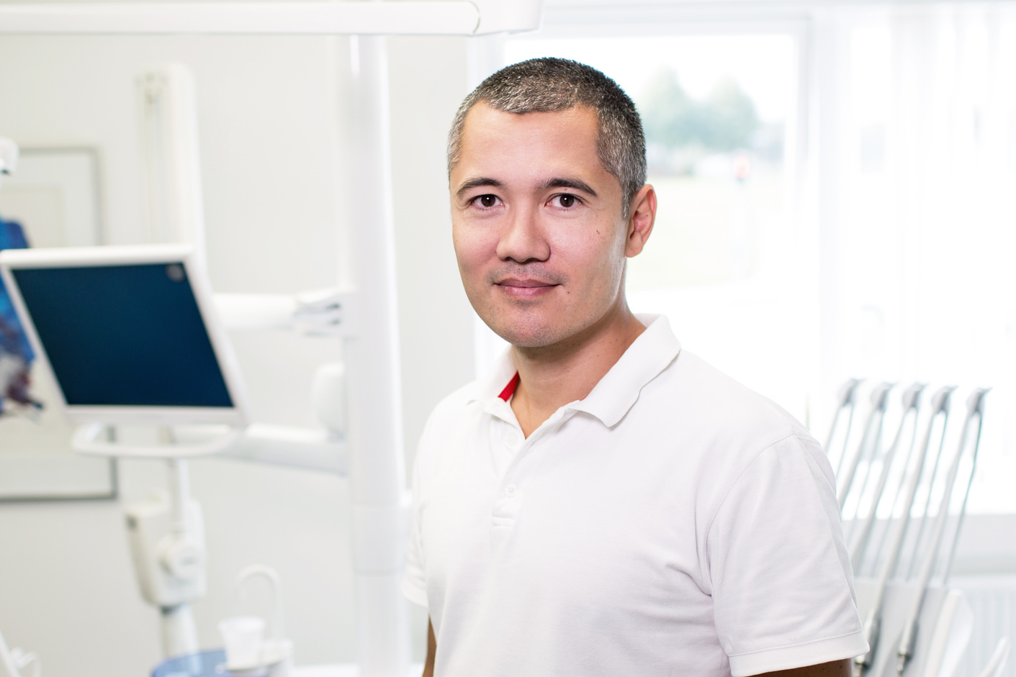
ADD A TEAM MEMBERS PAGE
Elaborate on what you want to discuss.
NAME
NAME
NAME
NAME
Title or Position
Title or Position
Title or Position
Title or Position

Slide 24


WRITE AN ORIGINAL STATEMENT OR INSPIRING QUOTE
— Include a credit, citation, or supporting message

Slide 25
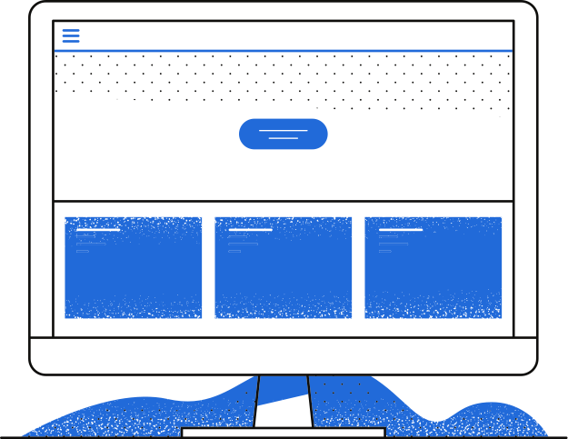
OBJECTIVES
OBJECTIVES
02
OBJECTIVES
OBJECTIVES
OBJECTIVES
OBJECTIVES
OBJECTIVES
OBJECTIVES
OBJECTIVES
OBJECTIVES
OBJECTIVES

Slide 26



STUDY OBJECTIVES
Objective 1
Objective 2
Objective 3
Briefly elaborate on what you want to discuss.
Briefly elaborate on what you want to discuss.
Briefly elaborate on what you want to discuss.

Slide 27

ADD A MAIN POINT
WRITE YOUR TOPIC OR IDEA
Elaborate on what you want to discuss.
ADD A MAIN POINT
Elaborate on what you want to discuss.
ADD A MAIN POINT
Elaborate on what you want to discuss.

Slide 28


ADD A MAIN POINT
ADD A MAIN POINT
ADD A MAIN POINT
WRITE YOUR TOPIC OR IDEA
Briefly elaborate on what you want
to discuss.

Slide 29

METHODOLOGY
METHODOLOGY
03
METHODOLOGY
METHODOLOGY
METHODOLOGY
METHODOLOGY
METHODOLOGY
METHODOLOGY
METHODOLOGY
METHODOLOGY
METHODOLOGY

Slide 30


SCHEDULE
1ST QUARTER
January
Double click to add task
February
Double click to add task
March
Double click to add task
2ND QUARTER
April
Double click to add task
May
Double click to add task
June
Double click to add task
3RD QUARTER
July
Double click to add task
August
Double click to add task
September
Double click to add task
4TH QUARTER
October
Double click to add task
November
Double click to add task
December
Double click to add task

Slide 31
Write a Heading Here

Slide 32

SUMMARY
SUMMARY
SUMMARY
04
SUMMARY
SUMMARY
SUMMARY
SUMMARY
SUMMARY
SUMMARY
SUMMARY
SUMMARY
SUMMARY
SUMMARY
SUMMARY

Slide 33

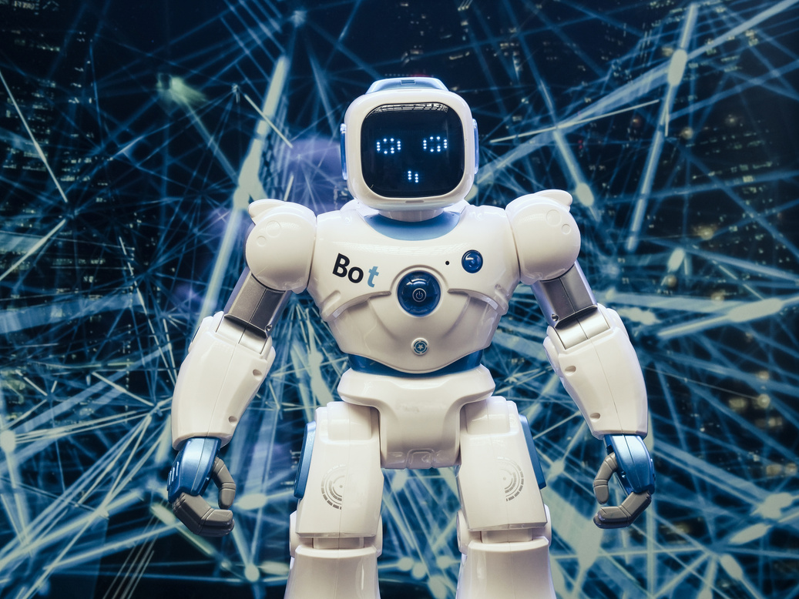


Write a caption for
the photos.

Slide 34


2 OUT OF 5
Elaborate on the featured statistic.
95%
Elaborate on the featured statistic.
12 MILLION
Elaborate on the featured statistic.

Slide 35

S
W
O
T
STRENGTHS
WEAKNESSES
OPPORTUNITES
THREATS
What are you doing well?
What sets you apart?
What are your
good qualities?
Where do you need
to improve?
Are resources adequate?
What do others do
better than you?
What are your goals?
Are demands shifting?
How can it be improved?
What are the blockers
you're facing?
What are factors outside
of your control?

Slide 36

REFERENCE LIST
Include a reference here (Author/Title/Publication)
Include a reference here (Author/Title/Publication)
Include a reference here (Author/Title/Publication)
Include a reference here (Author/Title/Publication)
Include a reference here (Author/Title/Publication)
Include a reference here (Author/Title/Publication)
Include a reference here (Author/Title/Publication)

Slide 37


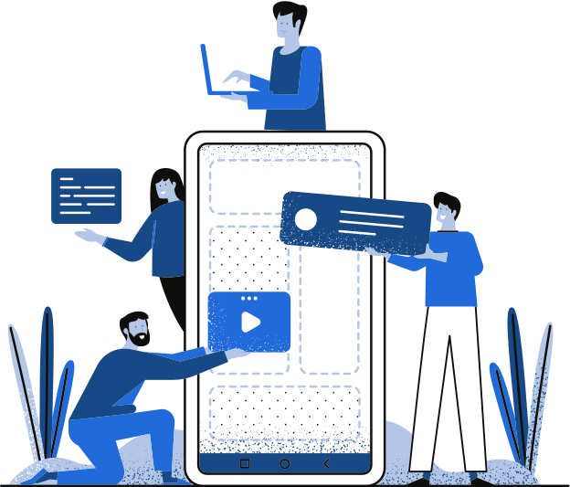
THANK YOU!
THANK YOU!
Write a closing statement or call-to-action here.

Slide 38

HAPPY DESIGNING!
CREDITS
This presentation template is free for everyone to use thanks to the following:
SlidesCarnival for the presentation template
Pexels for the photos

Slide 39

GET IN TOUCH
Email
hello@reallygreatsite.com
Social Media
@reallygreatsite
Call us
123-456-7890

Slide 40

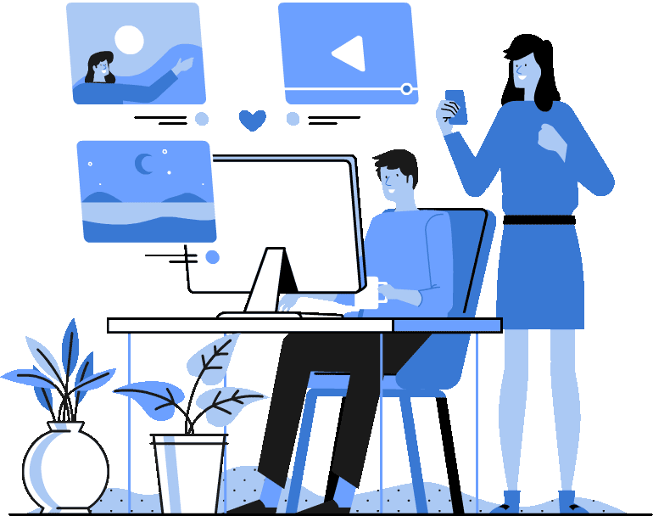
HAPPY DESIGNING!
FONTS IN THIS PRESENTATION
This presentation template uses the following free fonts:
Titles: Poppins Medium
Headers: Bitter
Body Copy: Bitter
You can find these fonts online too.

Slide 41


Add a main point
Add a main point
Add a main point
Add a main point
ADD A TIMELINE PAGE
Add a main point

Slide 42




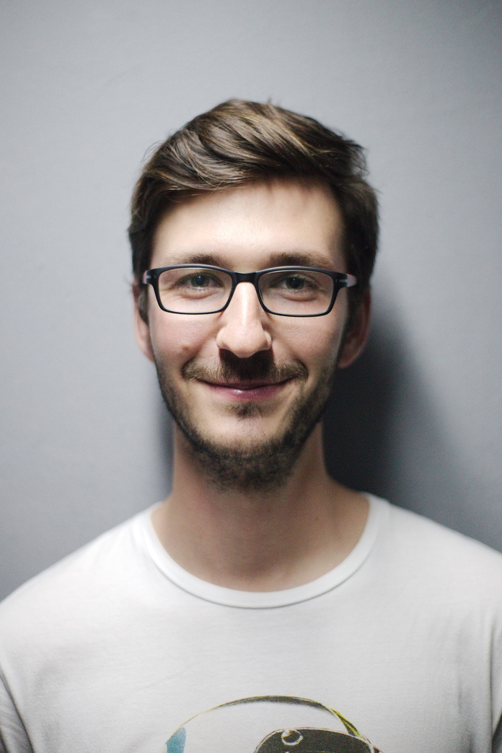


ADD A CHART PAGE
Name
Job Title
Name
Job Title
Name
Job Title
Name
Job Title
Name
Job Title
Name
Job Title
Name
Job Title

Slide 43
50
40
30
WRITE YOUR TOPIC OR IDEA
20
10
Elaborate on what you want to discuss.
0
Item 1
Item 2
Item 3
Item 4
Item 5

Slide 44







































RESOURCE
PAGE
Use these design resources in your Canva Presentation. Happy designing!
Don't forget to delete this page before presenting.

Slide 45

RESOURCE
PAGE
Use these design resources in your Canva Presentation. Happy designing!
Don't forget to delete this page before presenting.

Slide 46

FREE TEMPLATES FOR ALL YOUR PRESENTATION NEEDS
For PowerPoint, Google Slides,
and Canva
100% free for personal or commercial use
Ready to use, professional,
and customizable
Blow your audience away with attractive visuals

